Slide 1
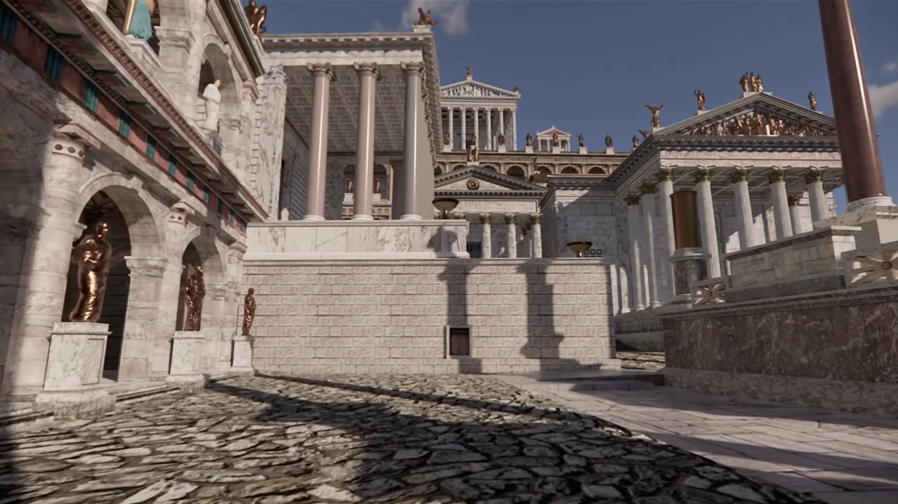





The Carolingian Provocation and the Need to Reread History
Wim Verbaal
Carolingian Literary Lab : an Erasmus Plus Blended Intensive Program
Poitiers, CESCM, 2023
Literatures without Borders
Notes:
I have changed a little bit the title as you can see, taking into account that we are talking about literature and not about history.

Slide 2
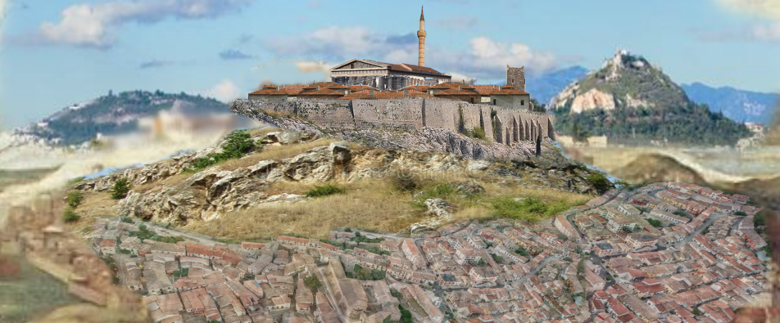
DE TRIBUS IMPOSTORIBUS
Notes:
Anyone who recognizes the site?

Slide 3
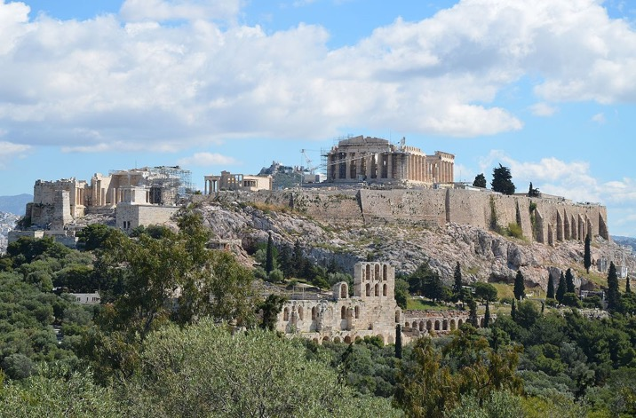
DE TRIBUS IMPOSTORIBUS
Notes:
This will be better known, I think.

Slide 4
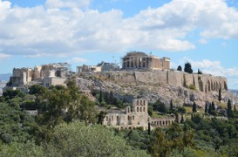
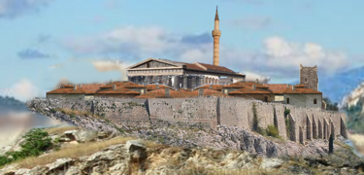
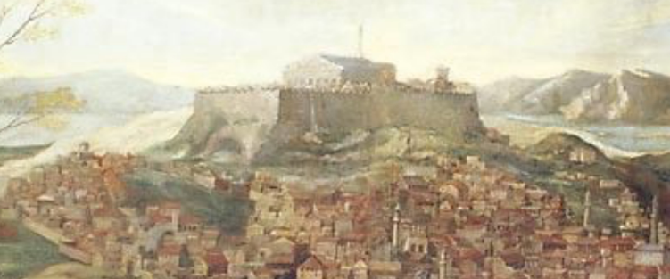
DE TRIBUS IMPOSTORIBUS
Notes:
But why do we not recognize the site as it looked for several centuries, while we recognize it as ‘authentic’ in a way it never looked?

Slide 5
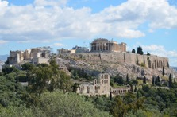
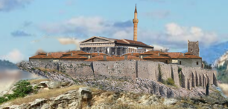
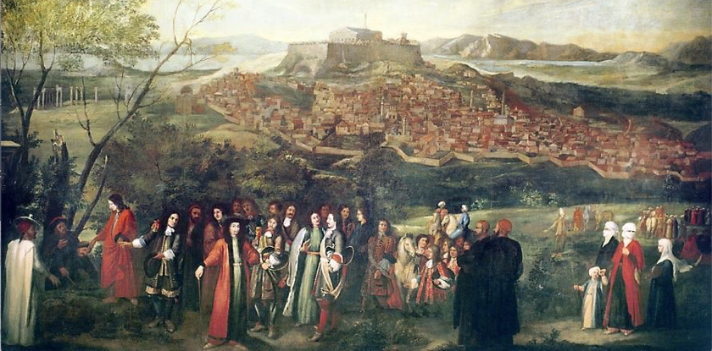
DE TRIBUS IMPOSTORIBUS
Notes:
Painting of 1674: Jacques Carrey or Arnould de Vuez, Le marquis de Nointel à Athènes.
Avant le bombardement et l’explosion de 1687

Slide 6


DE TRIBUS IMPOSTORIBUS
Notes:
The question is not what you like but what is historically correct or acceptable: the denudation till the nude stones or the continuation of the sacred tradition? Both images teach something about the way the past is treated. On the one side we are dealing with adoption of the past into the present. In the other with the imposing of the norms of the present unto the past.

Slide 7
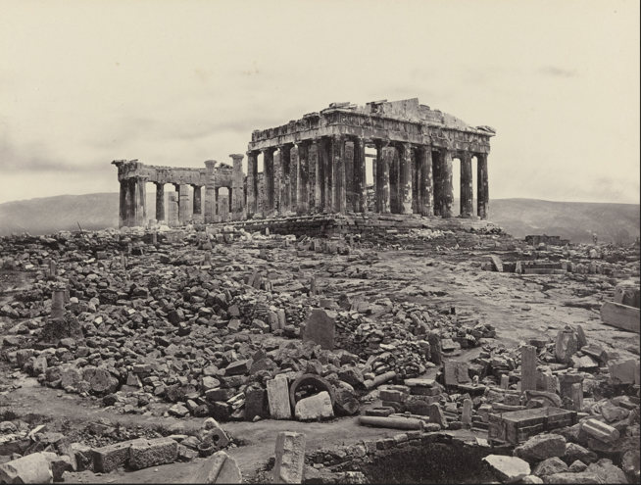
DE TRIBUS IMPOSTORIBUS
Notes:
1839: oldest photographs of what rests on the Acropolis. This is what we still see today – at least it seems so.

Slide 8


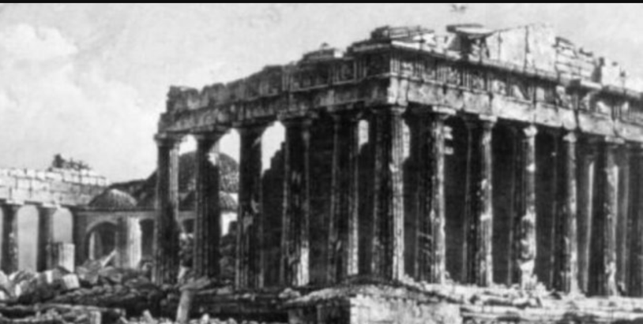
DE TRIBUS IMPOSTORIBUS
Notes:
The photographer took care not to show what he did not want to show and what remains almost invisible even on this photograph: the Parthenon-mosque!

Slide 9
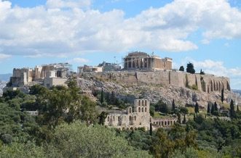

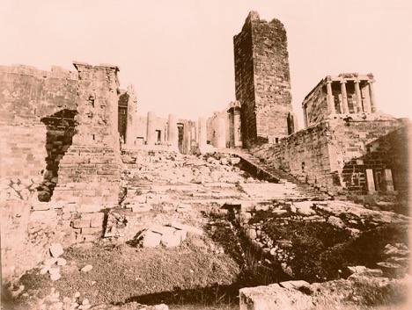
DE TRIBUS IMPOSTORIBUS
Notes:
But there is more that the photographer did not want to show. The Frankish tower survived till 1874 when it was destroyed by the Greek government under pressure (and with the money) of the ‘great’ archeologue Heinrich Schliemann. Nothing medieval should disturb the ‘pure classical’ view of the acropolis!

Slide 10

DE TRIBUS IMPOSTORIBUS
Notes:
So, what do we see now? Something stripped of all its history and brought back to something that never existed but that fancies the modern view on what Antiquity should be.

Slide 11
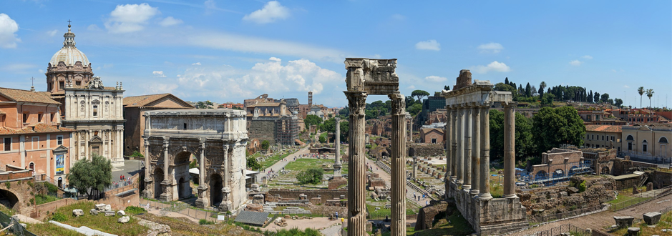
DE TRIBUS IMPOSTORIBUS
Notes:
Let us have a look at the Forum Romanum.

Slide 12
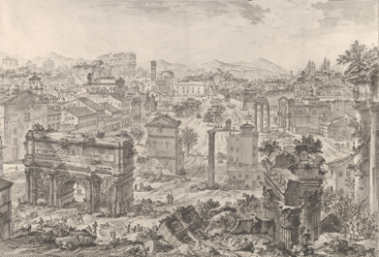
DE TRIBUS IMPOSTORIBUS
Notes:
We know how it looked like till the late 18th century thanks to the engravings by Piranesi. How should it look then?

Slide 13
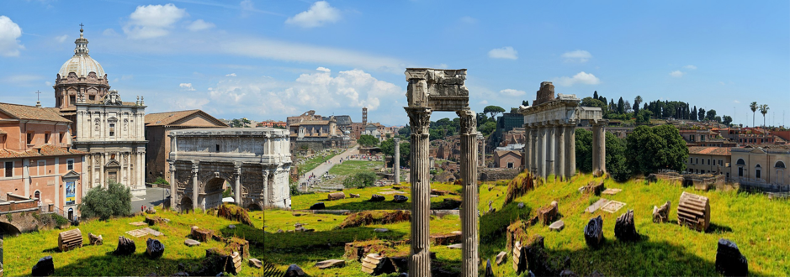
DE TRIBUS IMPOSTORIBUS
Notes:
Let us start by restoring the ground to its historical level, i.e., to the level the centuries deposed. Let us thus realize that the ‘original’ ground level of the Forum never has been touched by any Roman foot: it was paved with tuff stone or marble. That the ground we see now is the ‘original’ level is an archeological fairytale for tourists who then can be satisfied that our modern roads are better paved and walkable.

Slide 14
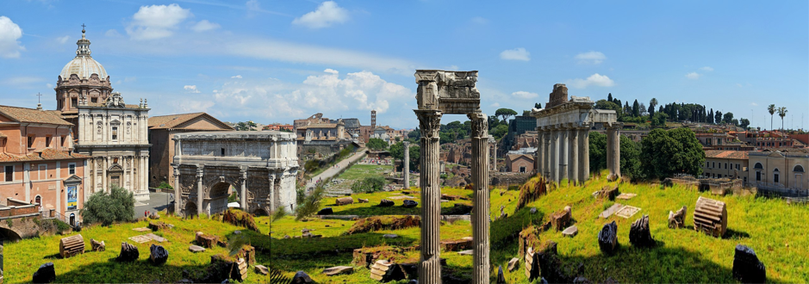
DE TRIBUS IMPOSTORIBUS
Notes:
Let us continue by replanting the elm avenue leading from the arch of Severus to S. Francesca Romana and that was planted in 1672 by pope Alexander VII. And as well restore the fountains that refreshed the people. Shadow and water are hard to find nowadays… But they were part of the Forum from Antiquity till the archeological destructions started.

Slide 15
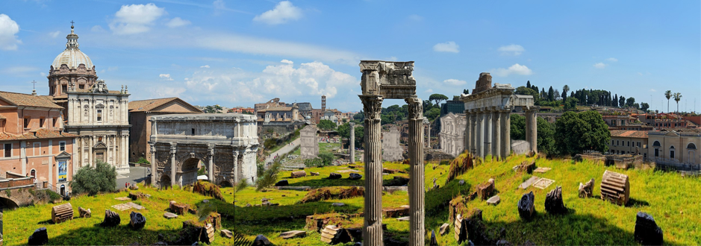
DE TRIBUS IMPOSTORIBUS
Notes:
Let uys finish by rebuilding some houses and dwellings on the site as well as the now demolished church of Santa Maria Liberatrice, originally built in the 13th century but rebuilt in 1617 by Onofrio Longhi and decorated by the artists most in vogue. It was dynamited in 1900 to ‘liberate’ the Roman church of Santa Maria Antiqua applauded by the archeological world who asked the demolition of the other churches to ‘free’ Antiquity from the millennia that followed it.

Slide 16




DE TRIBUS IMPOSTORIBUS
Notes:
I gave you the two most emblematic places of Antiquity to illustrate what we are actually looking at: nothing ‘antique’ but rather an Antiquity imposed upon history by stripping the places from their history.

Slide 17

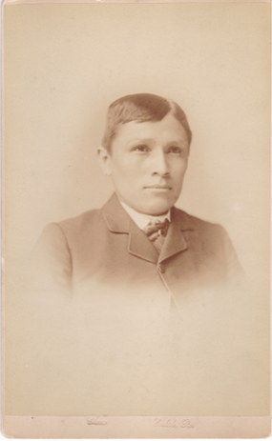
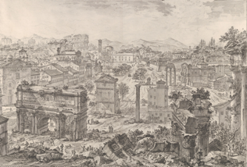

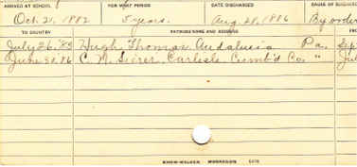
DE TRIBUS IMPOSTORIBUS
Notes:
I want to confront them with these two famous photographs that I fell again upon recently thanks to a book Ischa passed me. Tom Torlino, a Navajo boy, when entering Carlisle Indian Industrial School in 1882, a so-called Indian boarding school to integrate Indian children into American society. And four years later, when he leaves the school in 1886. ‘Human’ foundation: let us kill the Indian in him but save the man. This is what we now call colonization but that was at the moment called civilization: we kill the barbarian, the savage, and we cultivate him, we give him civillisation. We do away with what we consider barbarous and we transform him into a civilized man. The Pygmalion of George Bernard Shaw!
This is colonization in the purest sense: imposing your own view upon the other and cancelling the other’s history. Can anyone tell me what is the difference with what we see that happened on the Acroplois and on the Forum? For this reason I consider the Past the last domain that still has to be decolonized!

Slide 18
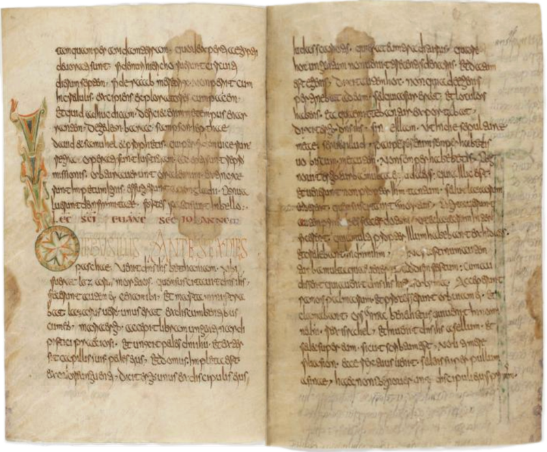
DE TRIBUS IMPOSTORIBUS
Notes:
Gallican Lectionary Luxeuil (2nd half 7th century). I return to the topic of this week. But by showing you first the beautiful Gallican Lectionary of Luxueil, our most important witness of the pre-Roman liturgical practices.

Slide 19
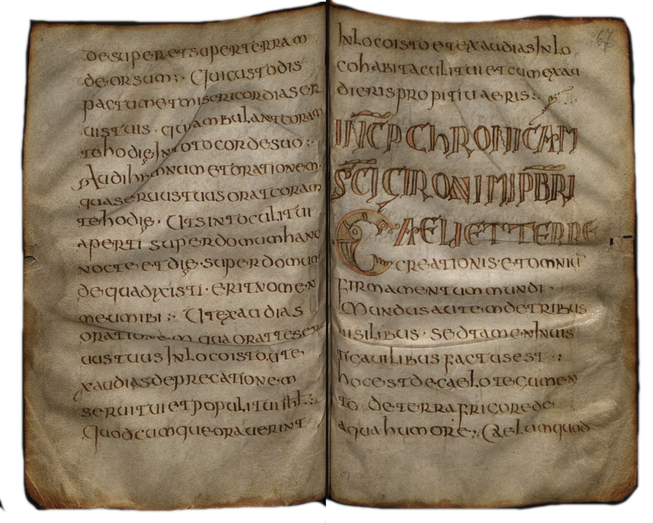
DE TRIBUS IMPOSTORIBUS
Notes:
Selestat Lectionary (ca. 700): another Merovingian lectionary and example of the pre-Carolingian cultural taste

Slide 20
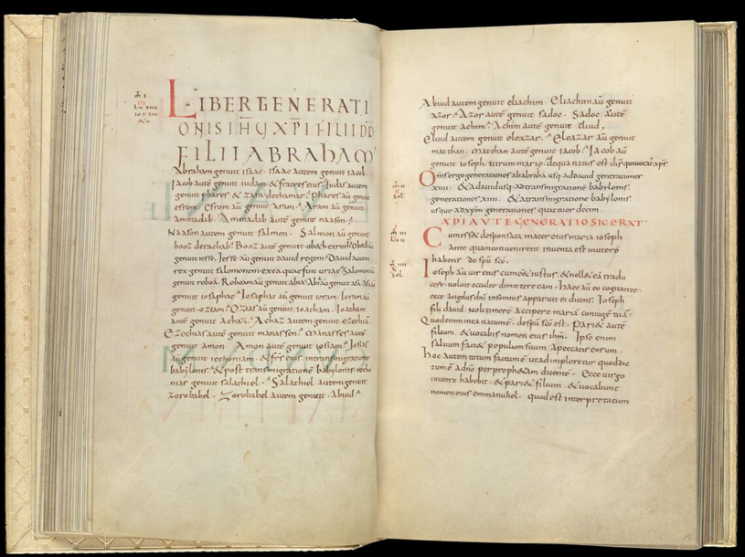
Notes:
Evangeliarium 825-850 (Metz? Cloisters: https://www.metmuseum.org/art/collection/search/693765) And here a Carolingian Evangeliary or Gospel book. What do you see?
Order, space, large margins, regularity, proportionally smaller writing, structuring use of colour

Slide 21
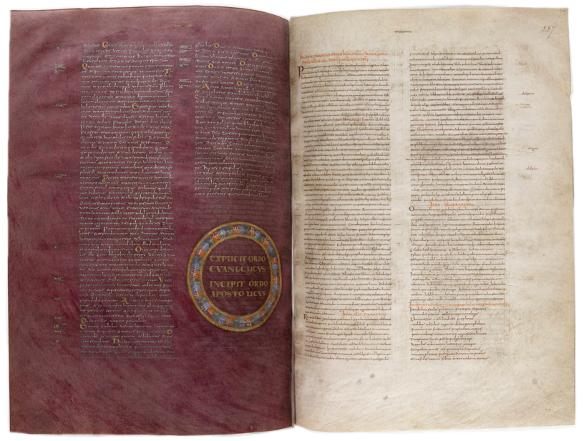
Notes:
Bible of Theofulf: a magnificent example of Carolingian book culture!
The purpur painting with gold writing: luxury but with a heavy significance, clarity in the lay-out, division of the tekst, regularity, order

Slide 22
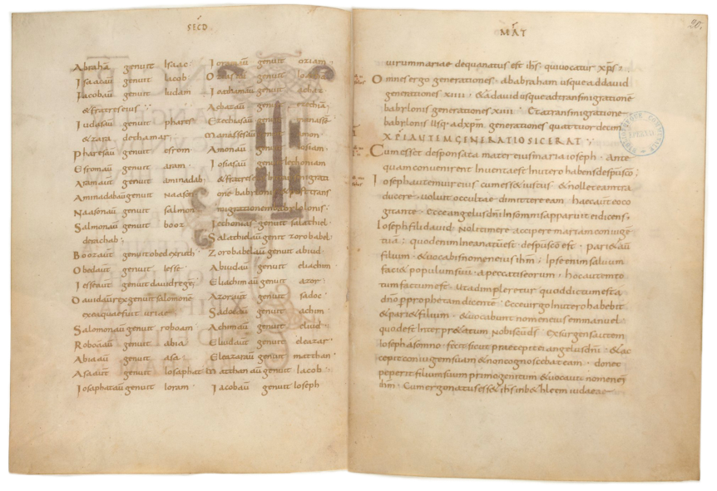
Notes:
Ebbo Evangeliarium (ca. 840’s): and another Gospel book.
Once again order, regularity, soberness but clarity

Slide 23
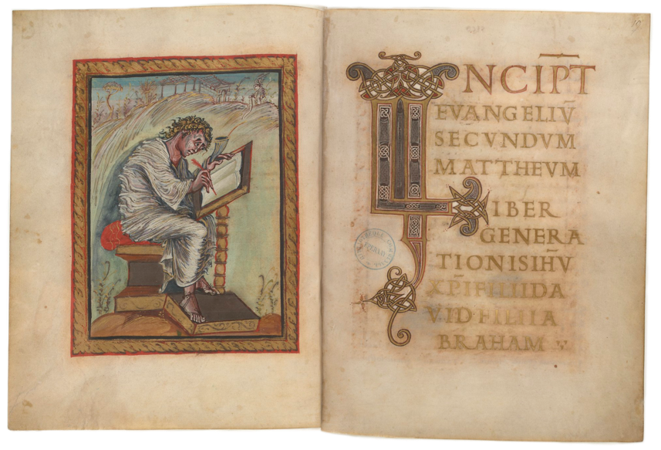
Notes:
Ebbo Evangeliarium (ca. 840’s)
Order, contenance, figurativity, clarity

Slide 24
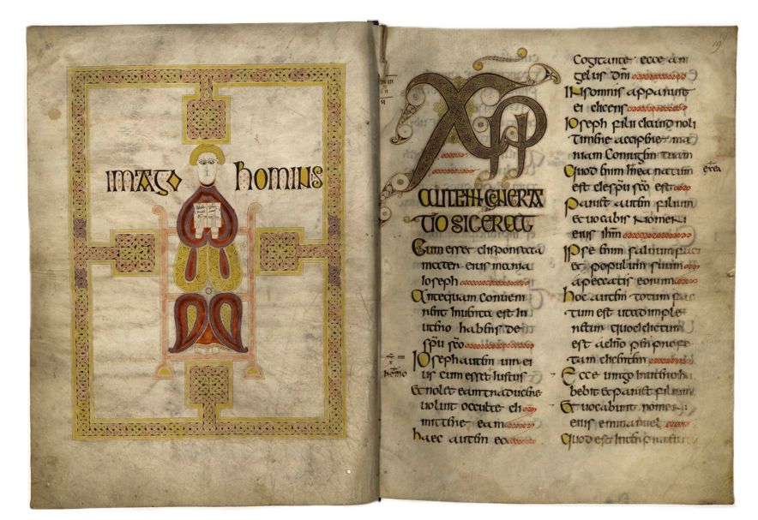
Notes:
Echternach Evalgenliarium (Northumbria? Ca. 700): back to Merovingian or Anglo-Saxon times
Abstract figurativity, the order is less geometrical but has a touch of liveliness, it is not kept within the imaginative borders, the frame is part of the illumination, not as a border but as part of the figure

Slide 25
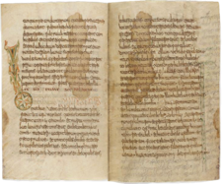
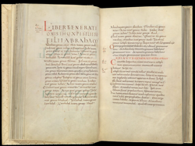
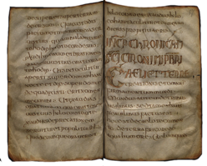
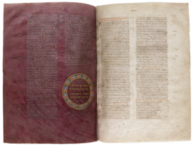
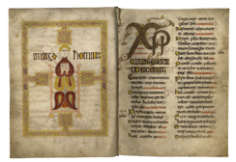

Notes:
Merovingian vs. Carolingian
Carolingian renaissance as an attempt to bring regularity into freedom, order into wildness, to cultivate the savagery, to bring contenance into life

Slide 26

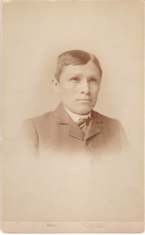
DE TRIBUS IMPOSTORIBUS
Notes:
Carolingian culture indeed as a civilisation or let us say colonization of the Merovingian and Germanic past

Slide 27
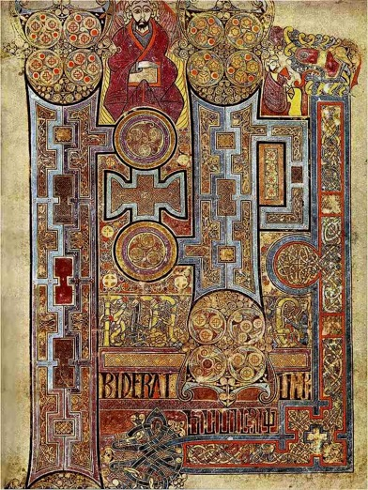
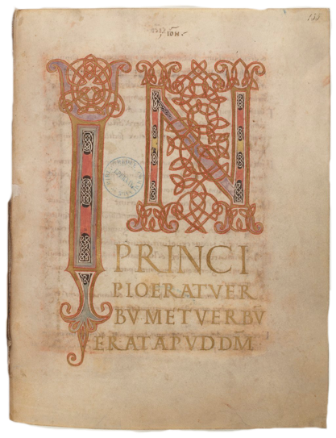
DE TRIBUS IMPOSTORIBUS
Notes:
Even clearer when compared to the Celtic tradition as in the book of Kells: here the opening of John in the book of Kells vs. that in the Ebbo Gospels

Slide 28

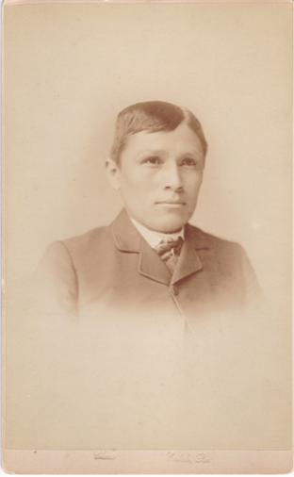
DE TRIBUS IMPOSTORIBUS
Notes:
Western society in its tendencey to civilize the savage, i.e., to replace history and memory of the ‘savage’ by our own modern Western view of what history is.

Slide 29
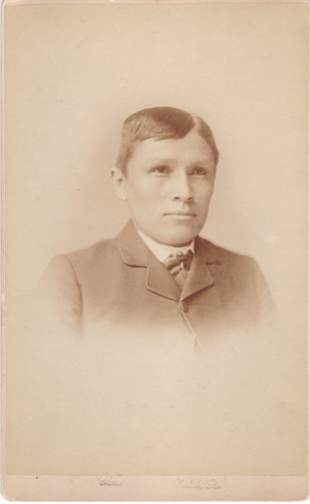
Notes:
But of course it is not that easy. We do not know what happened to Tom Torlino. Did he go back and did he throw away his imposed memory? Chance is small: American Governement wanted those children to break entirely with their past and tradition. Did he thus continue to live in American society as a ‘new American who will never have been accepted for being actually a ‘savage’?
It is this image of Tom Torlino that I needed to bring Carolingian poetics back to life.

Slide 30
DE TRIBUS IMPOSTORIBUS
Notes:
For, in the Carolingian colonization of the past, who is colonizing whom? Who is imposing another past and memory on whom? Whose history and memory are annihilated?
Indeed, nobody comes from the outside. The Carolingians are colonizing themselves: they are imposing themselves a history alien to theirs upon their own history and memory. They are replacing their own history and memory by another one that is not theirs.
They introduce a similar rupture into their past as the archeologues did and do. Yet with an important difference: the archeologues want to restore the past as how it truly has been (wie es eigentlich gewesen) or should have been… (Ranke’s statement contains an ambiguity). The Carolingians are not concerned about the past: they want the present to be reformed by the past, i.e., they want themselves to be civilized or colonized by a past that is not theirs.
I hope you see the difference and first of all the difficulty they encountered. Could they ever deny to be what they were? Could they ever pretend to be what they had never been?

Slide 31
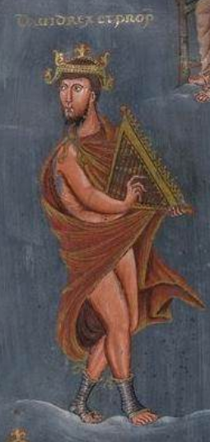
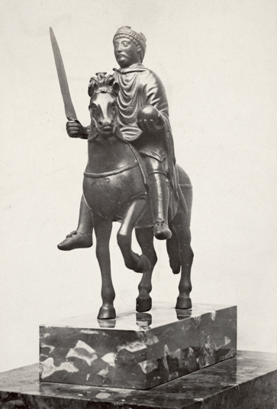
Notes:
Let us have a look at what this concrete means. You all know that Charlemagne’s nickname was David. We take these nicknames too often as a kind of puerile game. But it was not. It was deadly serious. Charlemagne had to be cultivated by the figure and culture of David. David’s past and memory ought to have been that of Charlemagne. Of course, impossible because Charlmagne could be no other than Charlemagne. And thus we have a problem, a serious schyzophrenia between what one imposes oneself to be and what one is.

Slide 32
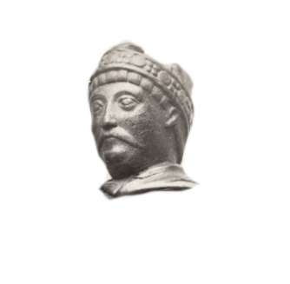
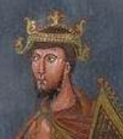
Notes:
Fortunately, Charlemagne was not dependent of others and could handle the ambivalence of Carolingian colonization of itself in better and more independent ways as the poor Tom Torlino ever will have been able to do.
But I think we have here one of the keys to understand the proper features of Carolingian literature. Let me make another jump and bring you back to one of the most famous manuscripts from Carolingian times.

Slide 33
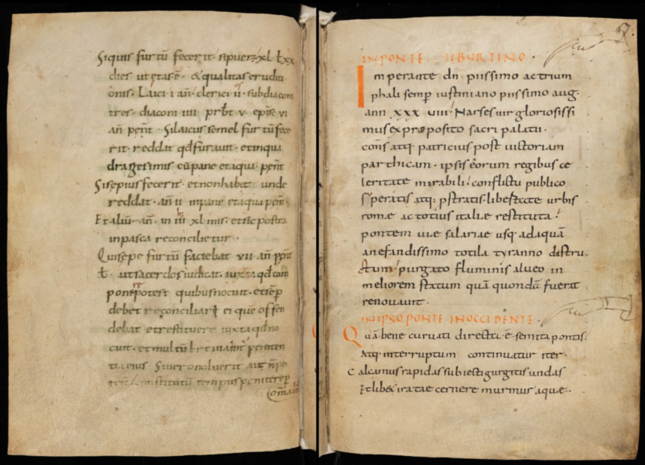
Einsiedeln 326 (1076)
Notes:
Many of you will know the Einsiedeln manuscript and the 9th century part of it that has interested so many scholars since the first texts from it were published in the late 19th century.

Slide 34
Einsiedeln, Stiftsbibliothek Codex 326 (1076)
ff. 67r-97v
9th century
Origin Reichenau (?): arrives in Einsiedeln from Pfäfers, daughter of Reichenau
Content:
Sylloge: Inscriptiones Urbis Romae (ff. 67r-79r)
Itineraria Urbis Romae (ff. 79v-85r)
Descriptio Murorum Urbis Romae (ff. 85r-86r)
Ordo Romanus 23 (ff. 86v-88v)
Anthologia (ff. 88v-97v)

Slide 35
Einsiedeln, Stiftsbibliothek Codex 326 (1076)
Sylloge: Inscriptiones Urbis Romae (ff. 67r-79r):
walking tour switching from the outsides to the insides of Rome but apparently always heading towards churches
two inscriptions in Greek
four inscriptions from Pavia
Itineraria Urbis Romae (ff. 79v-85r)
twelve walking routes mostly through Rome and following some processional routes
Descriptio Murorum Urbis Romae (ff. 85r-86r)
statistical walk alongside the wall, i.e., around Rome, from the Porta Scti Petri clockwise, adding the Hadrianum
Ordo Romanus 23 (ff. 86v-88v)
processions from Maundy Thursday to Holy Saturday between the churches of the Lateran and Jerusalem (now S. Croce in Gerusalemme)
Notes:
As you know or see, the manuscript opens with the oldest collection of inscriptions. They have been studied thoroughly as sources for lost inscriptions from Antiquity. They have more rarely been studied as part of the entire manuscript, i.e., in its dialogue with the other parts. My colleague has been starting to put it into its context.
The movement! The dynamics!

Slide 36
Einsiedeln, Stiftsbibliothek Codex 326 (1076)
Anthologia (ff. 88v-97v)
Riddle Poem on the black and the white knights (ff. 88v-89r)
Monastica de erumnis XII Herculis (ff. 89r-89v)
Conflictus versis et hiemis (ff. 89v-91r)
Iustius invidia nihil est… (f. 91r)
Titiro tu fido recubans… (f. 91r)
Anima pro diversis actibus… (Isidorus, prose, ff. 91r-91v)
Ad Septitianum (Martialis V.89 slot; m. probatio, f. 91v)
(Dittochaeum Prudentii) (ff. 91v-97v)
Epitaphium Geroldi (f. 97v)
Epitaphium Bernaldi (f. 97v, incomplete)
Notes:
One of the most important elements is that the sylloge at the beginning is answered by the poetic anthology at the end. This is also a collection but of poems.

Slide 37
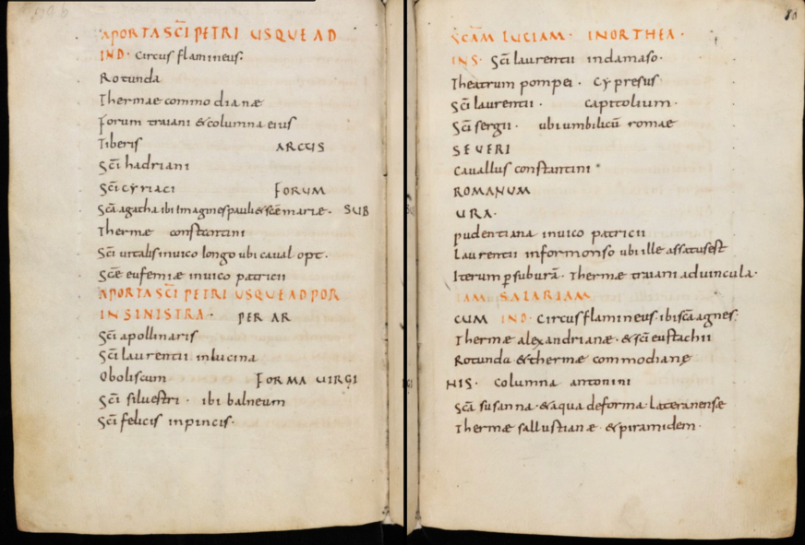
Notes:
What is so particular is that the Einsiedeln manuscript teaches us to read in a different way. This becomes most clear in the Itinera. A good colleague, former postdoc, now colleague at the Free University of Amsterdam, Klazina Staat, has studied the manuscript thoroughly. I quote her from an article that wil soon appear. She has called this way of reading ergodic reading (after Aarseth 1997), i.e. a way of reading that does not meet our modern Western way of reading: linear, left upper corner to right down corner, organized and following the path.

Slide 38
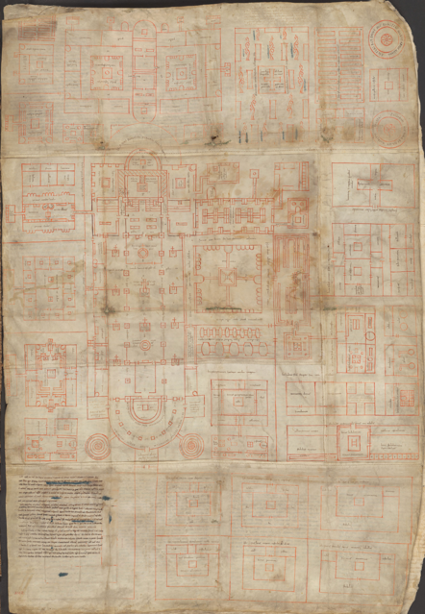
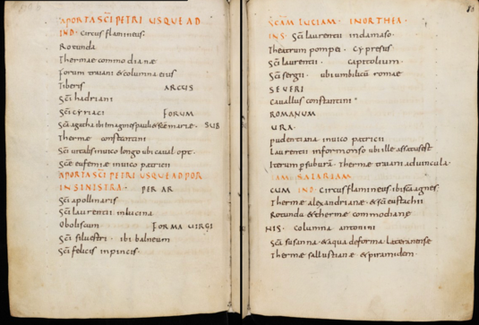
Notes:
My colleague for that reason links the Einsiedeln itinerarium to the monastic plan of St. Gallen. Both demand a particular way of reading and can be somehow seen as complementary to each other. The Einsiedeln itinerary tries to evoke in words the invisible images of Roman buildings and monuments. The Plan shows in the visual images of a monastery and church a sense that can be deducted from the inscriptions and lines as they are dispersed over the map. Let us have a closer look.

Slide 39
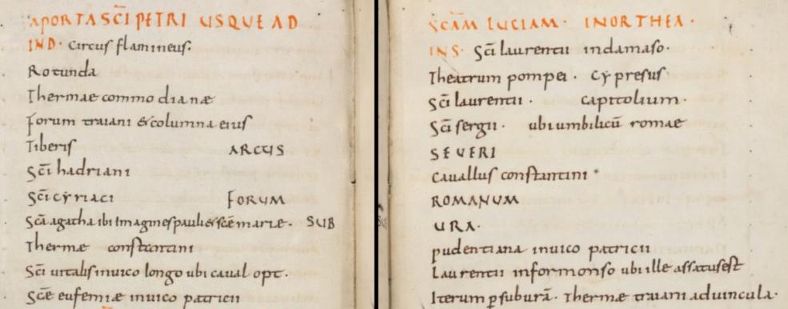
Notes:
Reading the itinerary.

Slide 40
Notes:
The difficulty that the composer had in visualizing what he was writing: he changed the direction left/right and let it even fall after the third itinirary.

Slide 41
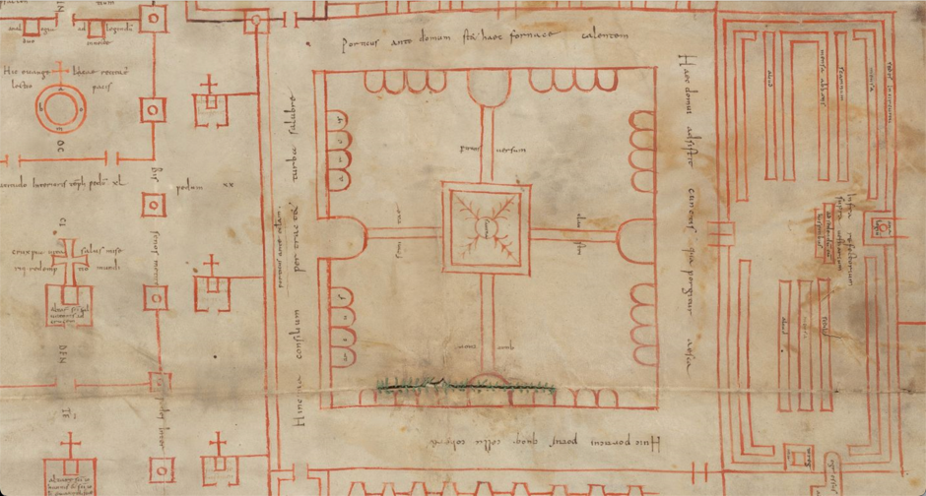
Notes:
The Plan asks a similar way of active reading forcing the reader to rid himself of the traditional way of reading and thus bringing the plan to life by his own moving around to read what is drawn.
However, we have approached both these ways of reading only in the two-dimensional way. As they appear on the page. But there is another dimension to it. Because both texts and images refer to something that is absent, or better, that is present only thanks to the words and the images in the mind of the reader. It is the reading movement from the letter to the sense, from the material and concrete reference to the imagined and spiritual meaning. The Symbolization of the universe as Francesco has stressed.

Slide 42
Nuper quoque quia vos, quando in praesentia vestra fui, compertum vos habere dixistis aliquod opusculum me noviter confecisse de sermonum proprietate et mystica rerum significatione; quod etiam a mea parvitate postulastis vobis dirigi: feci libenter quod petistis, et ipsum opus vobis, in viginti duobus libris terminatum, transmisi: ut, si Serenitati Vestrae placuerit, coram vobis relegi illud faciatis; et si aliquid in eo dignum emendatione repertum fuerit, cum vestris sagacissimis lectoribus, prout ratio dictat, illud emendare curetis.
Sunt enim in eo plura exposita de rerum naturis, et verborum proprietatibus, nec non etiam de mystica rerum significatione. Quod idcirco ita ordinandum aestimavi, ut lector prudens continuatim positam inveniret historicam et mysticam singularum rerum explanationem: et sic satisfacere quodammodo posset suo desiderio, in quo et historiae et allegoriae inveniret manifestationem.
Hrabanus Maurus
De rerum natura vel De universis
Praefatio prima ad Ludovicum
Notes:
That is what Hraban Maurus has done with his De universis: showing how all matter that can be caught in words by these words get a spiritualized other meaning. The first historical level is ‘colonized’ or cultivated with a spiritual level that is imposed upon the letter of the words and thus upon the thing the word is connected to. The ‘word’, or better, the tekst becomes the bridge between material reality and what it might signify.

Slide 43
Haec tibi servitii munuscula vilia parvi
Strabo tuus, Grimalde pater doctissime, servus
Pectore devoto nullius ponderis offert,
Ut cum consepto vilis consederis horti
Subter opacatas frondenti vertice malos,
Persicus imparibus crines ubi dividit umbris,
Dum tibi cana legunt tenera lanugine poma
Ludentes pueri, scola laetabunda tuorum,
Atque Volis ingentia mala capacibus indunt,
Grandia conantes includere corpora palmis :
Quo moneare habeas nostri, pater alme, laboris,
Dum relegis quae dedo volens, interque legendum
Ut vitiosa seces, deposco, placentia firmes.
Te deus aeterna faciat virtute virentem
Inmarcescibilis palmam comprendere vitae :
Hoc pater, hoc natus, hoc spiritus annuat almus.
Walahfrid Strabo
Hortulus
429-444
Notes:
This is what I tried to do and demonstrate in my analysis of Walahfrid’s Hortulus as a pedagogical treatise. I will only give one of the fragments that to me offered the clue to understanding what the poet was trying to say and do. I can only state that since I have been working on this tekst that was published now almost 20 years ago, I have been looking to understand what was the motivation behind this poetics? Was there a poetics behind this approach to tekst and poetry?
The clue was Walahfrid’s reference to the Persicus, the peach. For, where do we find the peach in the Plan of St; Gall?

Slide 44
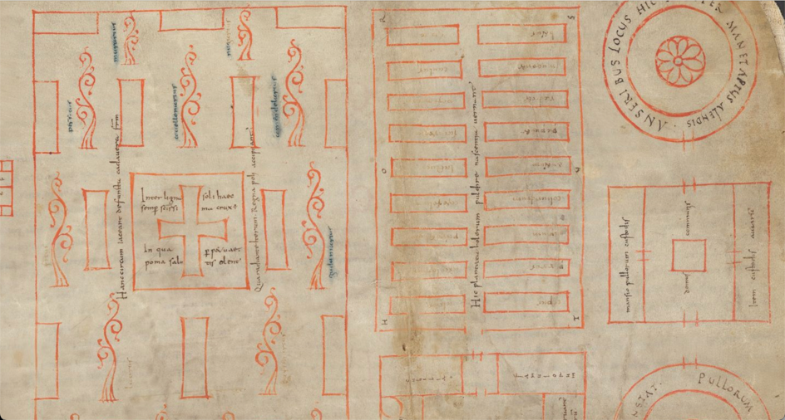
Notes:
Let us have a look. There is a place where we find trees and among them also the peach: it is the cimetery. We have to read the names of the trees in the direction of their growth!

Slide 45
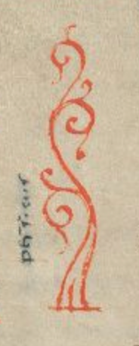
Haec tibi servitii munuscula vilia parvi
Strabo tuus, Grimalde pater doctissime, servus
Pectore devoto nullius ponderis offert,
Ut cum consepto vilis consederis horti
Subter opacatas frondenti vertice malos,
Persicus imparibus crines ubi dividit umbris,
Dum tibi cana legunt tenera lanugine poma
Ludentes pueri, scola laetabunda tuorum,
Walahfrid Strabo
Hortulus
429-444
Inter ligna soli haec / semper sanctissima crux
In qua perpetuae / poma salutis olent
Hanc circum iaceant defuncta cadavera fratrum
Qua radiante iterum Regna poli accipiant.
Notes:
Grimaldus is thus sitting under the peach tree at the cimetery when rereading the Hortulus, while his pupils are collecting the fruits, the poma. And what do we read around the cross in the centre of the cimetery. The children are thus collecting the fruits of the cross, i.e., as another tekst parallel to the names of the trees stipulates: the fruits of the dead brothers.

Slide 46

Tetricus, Italicis quondam regnator in oris Multis ex opibus tantum sibi servat avarus, At secum infelix piceo spaciatur Averno, Cui nihil in mundo, nisi vix fama arida restat. Quamquam thermarum vulgus vada praeparat olli, Hoc sine nec causa, nam omni maledicitur ore, Blasphemumque dei ipsius sententia mundi Ignibus aeternis magnaeque addicit abysso. Quam statuam vivo artifices si forte dederunt, Credito, blanditos insano hac arte leoni, Aut etiam, quod credo magis, miser ipse iubebat Haec simulacra dari, quod saepe superbia dictat. Infelix nam nullus erit, nisi deserit ipse Scire quod est, audens sese quod credere non est. Curribus atque in equis noris si stare superbos, Non quod sedit equo, tecum miraberis unquam.
Walahfrid,
Versus in Aquisgrani Palatio editi
De imagine Tetrici 30-43
Notes:
But of course there is a danger. And Walahfrid who belonged to the most intellectual and spiritual poetsof his time was well aware of it. Colonizing yourself with another past and constructing virtual realities to which you get entrance by way of the words and texts you use can make you into a copy of what you do not want to be. Walahfrid’s poem on the equestrian statue of Theoderic that was brought to Aachen seems to warn not to become pagan and too classical in colonizing yourself by Antiquity. For that reason he opposes to the dangerous Antiquity the Old Testamentary antiquity as the better spiritual colonization.

Slide 47

Notes:
Now, what do I want to say with this all? First, I draw a parallel between the way we from a modern point of view treat history and the way the Carolingians did. In both cases history is cultivated or collonized by denying history its history. However, we saw that modern time does so by pretending to restore a historical reality as it should have been but actually never was. The Carolingians on the contrary imposed an alien past unto themselves, pretending that they could be what they simply were not. They made Antiquity into themselves and transmitted this Antiquity to us as far as regards the literature.
And so, we are dealing with two perspectives of Antiquity: in the material sense we see a 19th/20th-century a-historicized Antiquity, consisting of replacing ruins into the time that they were no ruins. We are pretending Antiquity to have been a culture of ruins. We want the Romans to walk among ruins.
In the literary sense we are dealing with a Latin Antiquity that is entirely Carolingian, i.e., an Antiquity that was transformed to become the model for Carolingian reality.

Slide 48


Notes:
Now, what do I want to say with this all? First, I draw a parallel between the way we from a modern point of view treat history and the way the Carolingians did. In both cases history is cultivated or collonized by denying history its history. However, we saw that modern time does so by pretending to restore a historical reality as it should have been but actually never was. The Carolingians on the contrary imposed an alien past unto themselves, pretending that they could be what they simply were not. They made Antiquity into themselves and transmitted this Antiquity to us as far as regards the literature.
And so, we are dealing with two perspectives of Antiquity: in the material sense we see a 19th/20th-century a-historicized Antiquity, consisting of replacing ruins into the time that they were no ruins. We are pretending Antiquity to have been a culture of ruins. We want the Romans to walk among ruins.
In the literary sense we are dealing with a Latin Antiquity that is entirely Carolingian, i.e., an Antiquity that was transformed to become the model for Carolingian reality.

Slide 49

Notes:
Now, what do I want to say with this all? First, I draw a parallel between the way we from a modern point of view treat history and the way the Carolingians did. In both cases history is cultivated or collonized by denying history its history. However, we saw that modern time does so by pretending to restore a historical reality as it should have been but actually never was. The Carolingians on the contrary imposed an alien past unto themselves, pretending that they could be what they simply were not. They made Antiquity into themselves and transmitted this Antiquity to us as far as regards the literature.
And so, we are dealing with two perspectives of Antiquity: in the material sense we see a 19th/20th-century a-historicized Antiquity, consisting of replacing ruins into the time that they were no ruins. We are pretending Antiquity to have been a culture of ruins. We want the Romans to walk among ruins.
In the literary sense we are dealing with a Latin Antiquity that is entirely Carolingian, i.e., an Antiquity that was transformed to become the model for Carolingian reality. We may never forget that in all our 'classical' Latin texts, there is a Carolingian face looking at us.

